Slide 1
What is Forecasting?
What is a forecast?
??

Slide 2
Definition
Forecast is a statement of what is likely to happen in the future.
Forecasting may involve taking historical data and projecting them into the future with some mathematical model.
    Subjective judgements or intuitive prediction.
Forecasts are seldom perfect
There is no superior method for all organizations.
They are also costly and time consuming to prepare.

Slide 3
Types of Forecasts
Economic forecasts: for predicting e.g. inflation rate, money supply, housing statistic, etc.
Technological forecasts: for predicting the rate of technological change.
Demand forecasts: for predicting sales of products.

Slide 4
The forecast is the only estimate of demand until actual demand becomes known.
Forecasts of demand therefore drive decisions in many areas
Human Resources – Hiring, training, laying off workers depend on anticipated demand
Capacity – Capacity shortages can result in undependable delivery, loss of customers, loss of market share
Supply-Chain Management – Good supplier relations and price advantages for materials and parts depend on accurate forecasts
Good forecasts are of critical importance in all aspects of a business.

Slide 5
FORECASTING TIME HORIZONS
Short-range forecasts: has time span of up to 1 year but generally less than 3 months. Useful for planning purchasing, job scheduling production levels etc
Intermediate forecasts: generally spans from 3 months up to 3 years. Useful for sales planning, production planning and budgeting.
Long-range forecasts: Generally 3 years or more. Useful for planning new products, facility location or expansion.

Slide 6
Approaches to Forecasting
Two main approaches: Quantitative & Qualitative
Quantitative Forecasting: historical data and/causal variables use mathematical models,
Qualitative Forecasting: incorporates the factors such as the subjective judgments, intuition, experience and expert knowledge in reaching a forecast.

Slide 7
These forecasts are also known as judgmental forecasts and they are
frequently used to adjust quantitative forecasts. These methods include:
Jury of Executive Opinion: makes use of the opinions of a small group of high-level managers, often in combination with statistical models
Sales Force Composite: Each sales person estimates what sales will be in his/her region, forecasts reviewed to ensure it is realistic, and then combined at the district and national levels to reach an overall forecast
Delphi Method: Makes use of opinions of expert who may be located at different places (process iterative).
Consumer Market Surveys: Solicits input from customers or potential customers regarding their future purchasing plans.

Slide 8

When Do we use Qualitative Forecasting Approaches
Used when situation is vague, there is high level of uncertainty and where little data exist
  New products
  New technology
  Times of Economic and
  political upheaval
Involves intuition, experience
  e.g., forecasting sales on Internet

Slide 9
Quantitative Methods Focus
Used when situation is ‘stable’ and historical data exist
      Existing products
      Current technology
Also used when forecasting for the short to medium term when certainty is high
Involves mathematical techniques
  e.g., forecasting sales of color televisions

Slide 10
Quantitative Approaches
Naive approach
Moving averages
Exponential smoothing
Trend projection
Linear regression
Time-Series Models
Causal Models

Slide 11
DECOMPOSITION OF TIMES SERIES
Depends on a series of evenly spaced data points
Depends on historical data
Weekly, monthly etc
Any other variable not showing up in past data is ignored
Decomposition of Times Series:
Trend (T) – gradual upward or downward movement of the data over time.
Seasonality (S)- a data cycle that repeats itself after a period
Cycles (C) – patterns in the data that occur every several years
Random variations (R)- blips in the data caused by chance and unusual situations

Slide 12
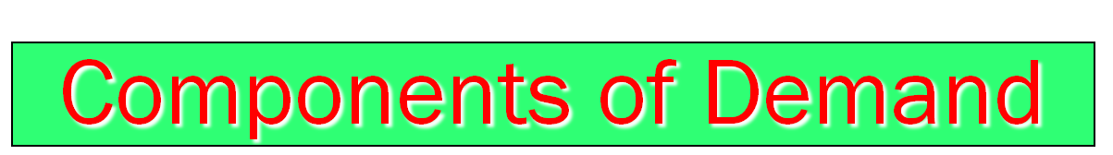
Trend component
Seasonal peaks
Actual demand
Demand for product or service
Average demand over four years
Random variation
| | | |
1 2 3 4
Year

Slide 13
Naive Approach
Assumes demand in next period is the same as demand in most recent period
  e.g., If May sales were 48, then June’s forecast will be 48
Sometimes cost effective and efficient
Good as a starting forecasting method
akintsiful@yahoo.com

Slide 14
Example of Naive Approach
Year | Actual Demand (A_{t}) | Forecast (F_{t}) | Notes
1 | 100 | -- | There was no prior demand data on which to base a forecast for period 1
2 | 300 |  | From this point forward, these forecasts were made on a year-by-year basis.
3 | 200
4 | 500
5 | 600
6 | 700
7

Slide 15
Moving Average Method
assumes that demand in the next period is the average demand over a specified number of periods
  Useful if we can assume that market demand will be fairly stable over time.
Moving Average =∑ Demand in previous n period
n
Where n is the number of periods

Slide 16
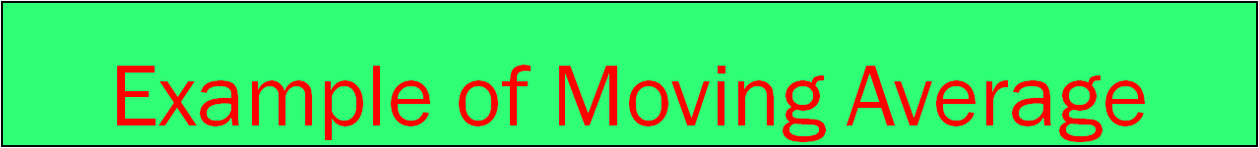
Actual 3-Month
Month Shed Sales Moving Average
10
12
13
(10 + 12 + 13)/3 = 11 ²/₃
January 10
February 12
March 13
April 16
May 19
June 23
July 26

Slide 17
Weighted Moving Averages
When there is a trend or a pattern, weights can be used to place more emphasis on recent values.
This makes the technique more responsive to changes.
Weighted Moving Average = ∑ (weight for period n) (Demand in previous n months)
Sum of weights

Slide 18
Weighted Moving Average
Coke sales at Oguaa Retail Store are shown in Table A. Table B shows the weights to be applied to different months. Use this information to conduct:
A three-month weighted moving average;
Table A
Month | Coke sales
January | 10
February | 15
March | 16
April | 12
May | 21
June | 28
July | 30
August | 14
September | 13
October | 16
November | 11
December | 19
Table B
Weights Applied | Period
3 | Last month ago
2 | Last two months ago
1 | Last three months ago
6 | Total

Slide 19
The demand for defense machinery for a certain project is given each month as follows:
The defense officer is asked to forecast the demand for the 11th month using three period moving average technique.
Month | Demand
1 | 120
2 | 110
3 | 90
4 | 115
5 | 125
6 | 117
7 | 121
8 | 126
9 | 132
10 | 128
  The defense officer has decided to use a weighting scheme of 0.5, 0.3, 0.2 and calculated the weighted moving average for the 11th month as follows.
  Weighted MA(3):
  F₁₁ = 0.5(128) + 0.3(132) + 0.2(126) = 64 + 39.6 + 25.2 = 128.2

Slide 20
Exponential Smoothing
A type of moving average that requires little historical data.
New forecast = last period’s forecast + α ( last period’s actual demand – last period’s forecast)
F_{t} = F_{t-1} + α (A_{t-1} –F_{t- 1})
α is a weight or smoothing constant that has values between 0 and 1 inclusive
Requires smoothing constant (α)
  Ranges from 0 to 1
  Subjectively chosen

Slide 21
Example of Exponential Smoothing
Predicted demand = Balls of Kenkey = 142
Actual demand = 153
Smoothing constant α = 0.20
New forecast = ???

Slide 22
Effect of Smoothing Constants
Weight Assigned to
Most 2nd Most 3rd Most 4th Most 5th Most
Recent Recent Recent Recent Recent
Smoothing Period Period Period Period Period
Constant (α) α(1 - α) α(1 - α)² α(1 - α)³ α(1 - α)⁴
α = 0.1 0.1 0.09 0.081 0.073 0.066
α =0 .5 0.5 0.25 0.125 0.063 0.031

Slide 23

225 –
200 –
175 –
150 –
Actual demand
α = .5
Demand
α = .1
| | | | | | | | |
1 2 3 4 5 6 7 8 9
Quarter

Slide 24
Choosing α
The objective is to obtain the most accurate forecast no matter the technique
We generally do this by selecting the model that gives us the lowest forecast error
Forecast error = Actual demand - Forecast value
= A_{t} - F_{t}

Slide 25
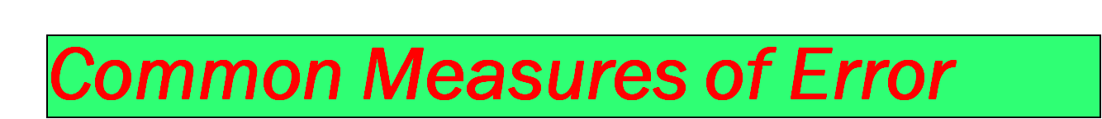
(i) Mean Absolute Deviation (MAD)
∑ |actual - forecast|
n
MAD =
(ii) Mean Squared Error (MSE)
∑ (forecast errors)²
n
MSE =

Slide 26
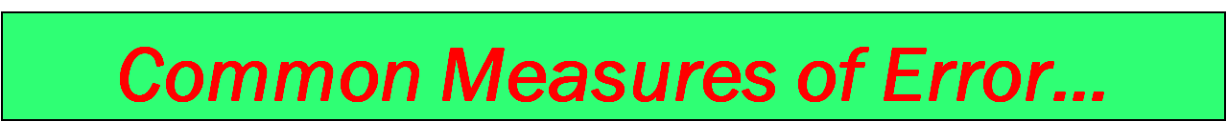
(iii) Mean Absolute Percent Error (MAPE)
n
i = 1
100 ∑ |actual_{i} - forecast_{i}|/actual_{i}
n
MAPE =

Slide 27
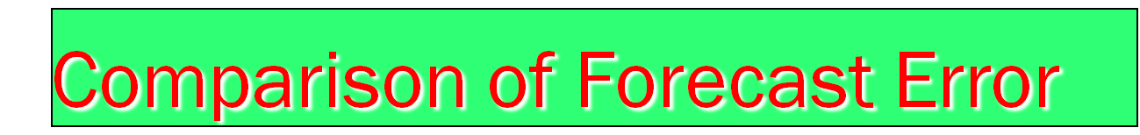
Rounded Absolute Rounded Absolute
Actual Forecast Deviation Forecast Deviation
Tonnage with for with for
Quarter Unloaded α = .10 α = .10 α = .50 α = .50
1 180 175 5 175 5
2 168 176 8 178 10
3 159 175 16 173 14
4 175 173 2 166 9
5 190 173 17 170 20
6 205 175 30 180 25
7 180 178 2 193 13
8 182 178 4 186 4
84 100

Slide 28
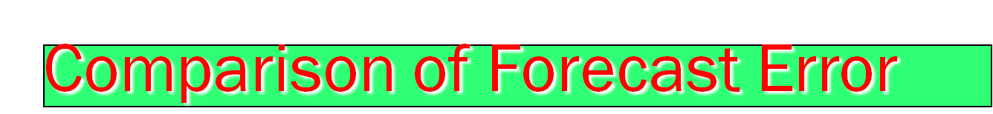
∑ |deviations|
n
MAD =
Rounded Absolute Rounded Absolute
Actual Forecast Deviation Forecast Deviation
Tonage with for with for
Quarter Unloaded α = .10 α = .10 α = .50 α = .50
For α = 0 .10
1 180 175 5 175 5
2 168 176 8 178 10
3 159 175 16 173 14
4 175 173 2 166 9
5 190 173 17 170 20
6 205 175 30 180 25
7 180 178 2 193 13
8 182 178 4 186 4
84 100
= 84/8 = 10.50
For α = .50
= 100/8 = 12.50

Slide 29
Trend Projections
Fits a line to historical data and then projects it into the future for medium-to-long-range forecasts.
Several mathematical trend equations can be developed
(e.g. linear, exponential or quadratic). The most popular ones make use of a linear trend line and least squares method .
This approach will yield a straight line that minimises the sum of the squares of the vertical differences from the line to each of the actual observation.
Least square lines are described by ŷ =a + bx
Ŷ value to be computed
a is the y-axis intercept
b is the slope of the regression line or rate of change in y
X is the independent variable, which is time in this case

Slide 30
Least Squares Method
Actual observation
(y value)
Deviation₇
Deviation₅
Deviation₆
Values of Dependent Variable
Deviation₃
Deviation₄
Deviation₁
Deviation₂
^
Trend line, y = a + bx
Time period

Slide 31
Least Squares Method
Equations to calculate the regression variables
^
y = a + bx
Σxy - nxy
Σx² - nx²
n(Σxy) – (Σx)(Σy)
n(Σx²⁾ – (Σx)²
b =
OR b =
OR Σy –bΣx
n
a = y - bx

Slide 32
Least Squares Example
Time Electrical Power
Year Period (x) Demand x² xy
1999 1 74 1 74
2000 2 79 4
2001 3 80 240
2002 4 90 16
2003 5 105 525
2004 6 142 36
2005 7 122 49
Σx = 28 Σy = 692 Σx² = ??? Σxy = ???
x = ? y = ????
Σxy - nxy
Σx² - nx²
b =
=????
a = y - bx =???

Slide 33

Used when changes in one or more independent variables can be used to predict the changes in the dependent variable
Most common technique is linear regression analysis
We apply this technique just as we did in the time series example

Slide 34
Causal Forecasting
Forecasting an outcome based on predictor variables using the least squares technique
^
y = a + bx
^
where y = computed value of the variable to be predicted (dependent variable)
a = y-axis intercept
b = slope of the regression line
x = the independent variable though to predict the value of the dependent variable

Slide 35

Sales Area Payroll
(GHS000,000), y (GHS000,000,000), x
2.0 1
3.0 3
2.5 4
2.0 2
2.0 1
3.5 7
4.0 –
3.0 –
2.0 –
1.0 –
Sales
| | | | | | |
0 1 2 3 4 5 6 7
Area payroll

Slide 36
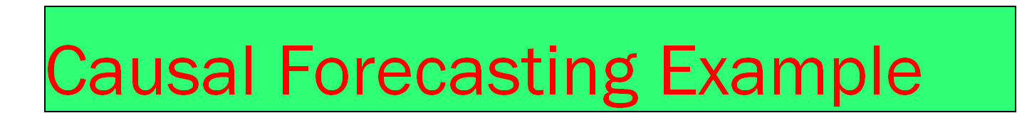
Sales, y Payroll, x x² x y
2.0 1 1 2.0
3.0 3 9 9.0
2.5 4 16 10.0
2.0 2 4 4.0
2.0 1 1 2.0
3.5 7 49 24.5
∑y = 15.0 ∑x = 18 ∑x² = 80 ∑x y = 51.5
∑xy - nxy
∑x² - nx²
51.5 - (6)(3)(2.5)
80 - (6)(3²)
x = ∑x/6 = 18/6 = 3
b = = =0.25
y = ∑y/6 = 15/6 = 2.5
a = y - bx = 2.5 - (0.25)(3) = 1.75

Slide 37
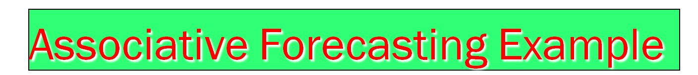
^
y = 1.75 + .25x
Sales = 1.75 + 0.25(payroll)
If payroll next year is estimated to be GHS600 million, then:
4.0 –
3.0 –
2.0 –
1.0 –
3.25
Sales
Sales = 1.75 + .25(6)
Sales = GHS325,000
| | | | | | |
0 1 2 3 4 5 6 7
Area payroll

Slide 38


The End
Thank you

